Slide 1

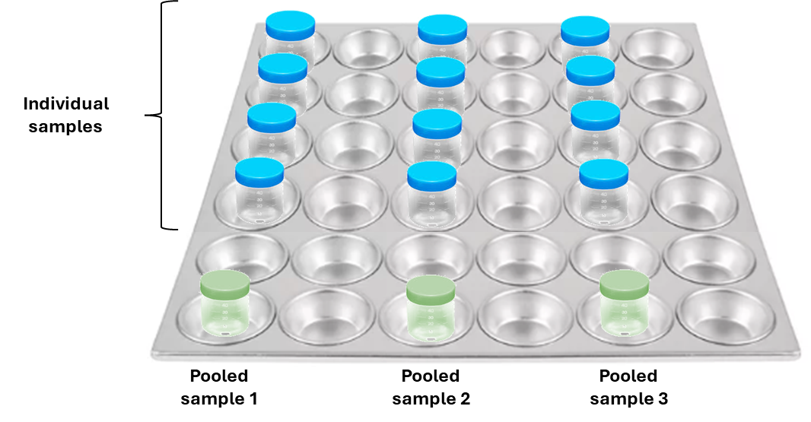
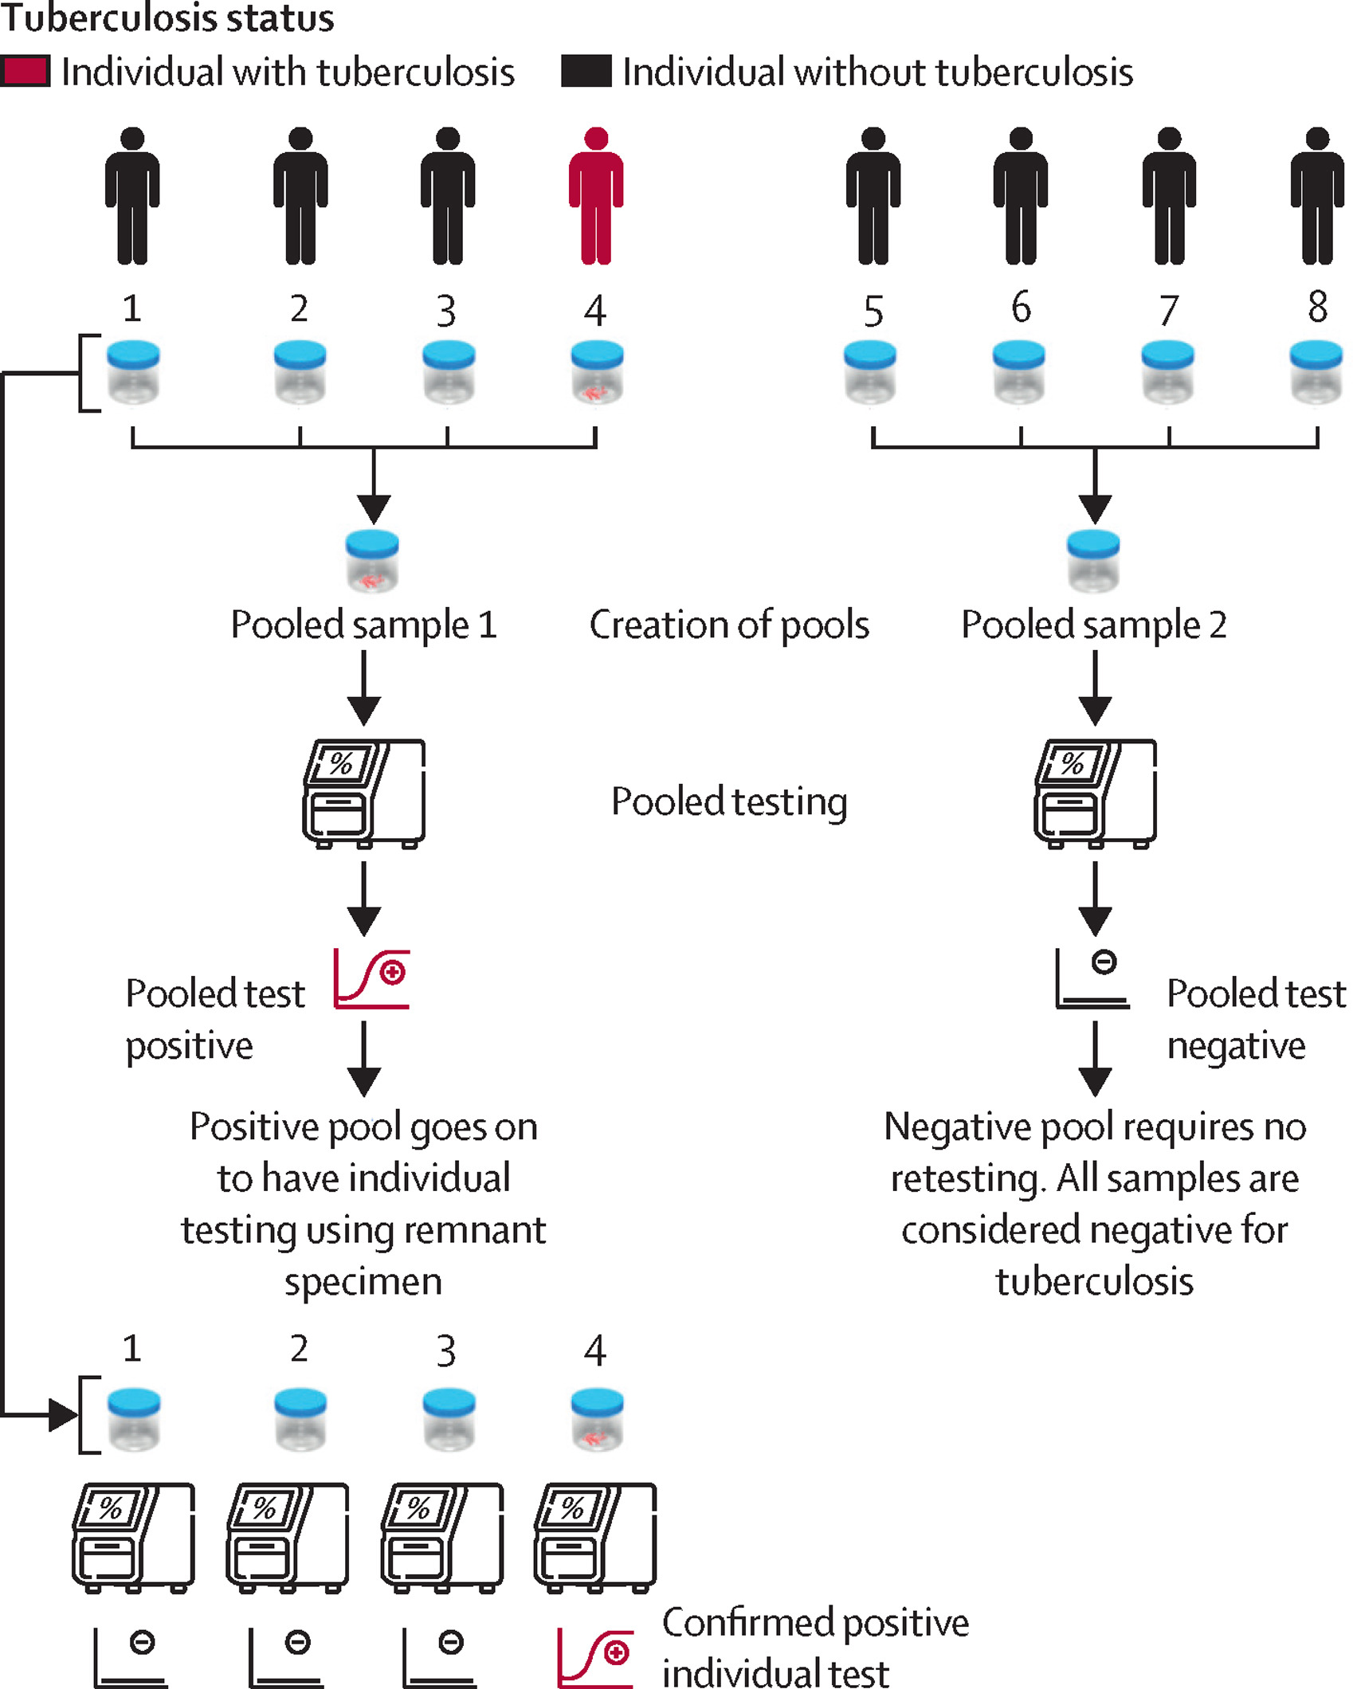
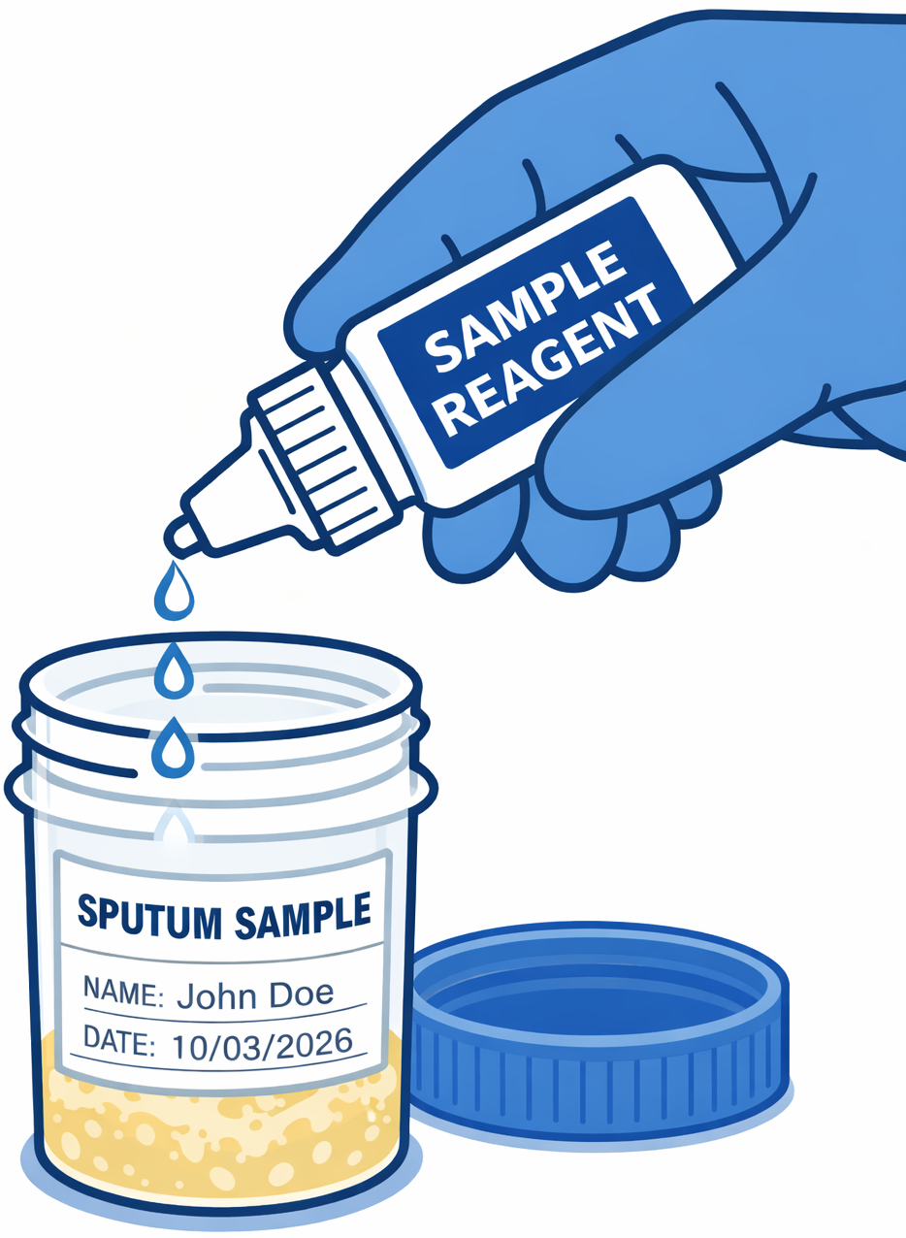
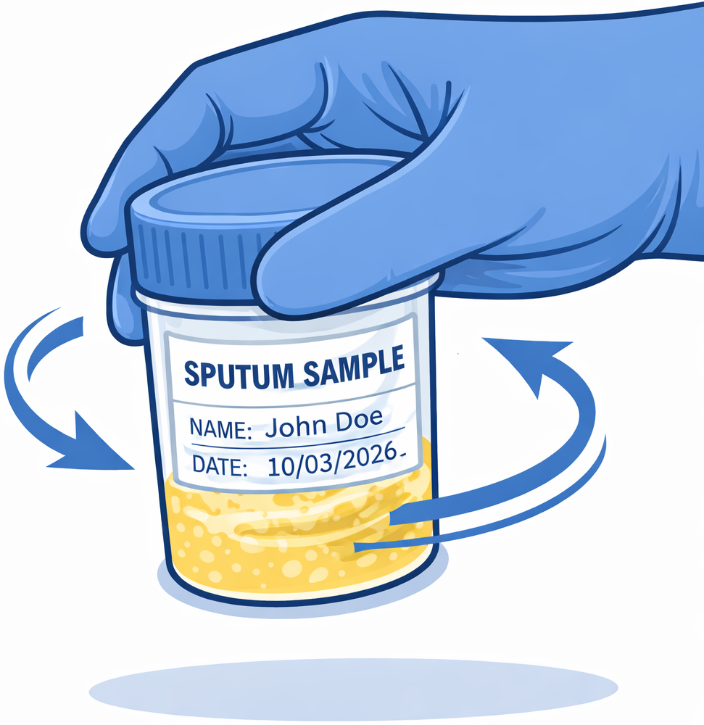


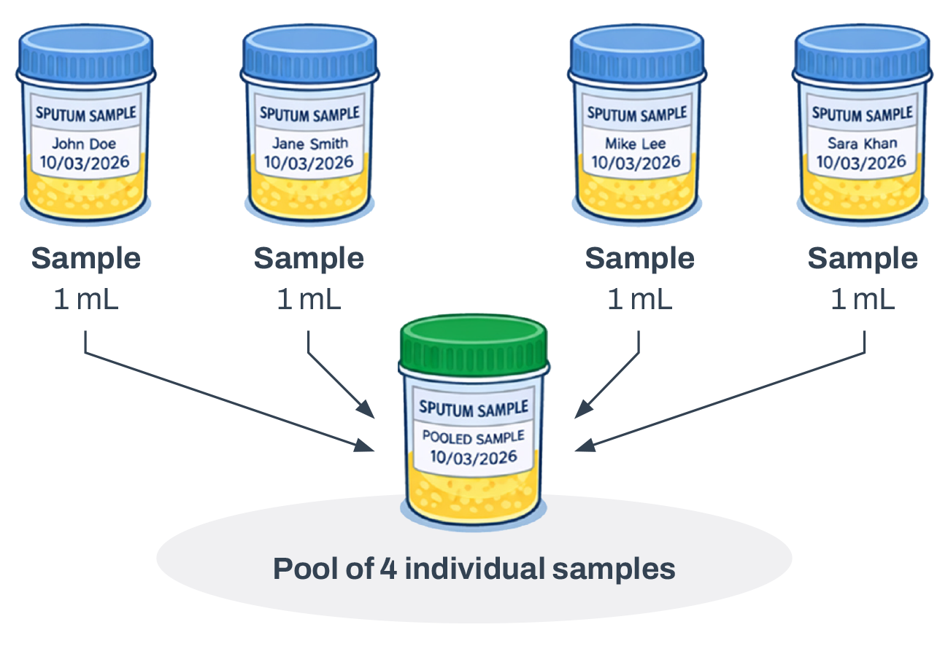




Pooled Sputum Testing for Tuberculosis Diagnosis
Laboratory Workflow using LC-aNAAT - Step-by-step guide
Step 1: Specimen Eligibility
Step 4: Interpretation of Results
If pooled result = MTB not detected: → All specimens are interpreted as negative → No further testing is required
If pooled result = MTB detected or trace: → Perform individual testing for all specimens in the pool → Use remaining processed specimen If pooled result = Error, invalid, or no result (non-valid): Follow the Laboratory procedure for non-valid results. → Repeat pooled test if volume remains, OR → Perform individual testing of all specimens in the pool. Clinical decisions are based on the individual test results.
Sputum specimen (not saliva)
Minimum 1 mL of raw sputum
Adequate quality sample
Properly labelled specimen
Do NOT pool specimen if:
❌ Low volume (< 1 mL)
❌ Unsuitable for LC-aNAAT
Step 2: Specimen Preparation
1. Place all specimen on the tray.
2. Process each specimen with sample reagent according to routine LC-aNAAT procedures. Example:
A.
B.
C.
D.
E.
Step 3: Pool Preparation
Mix each processed specimen to re-homogenise.
Transfer equal aliquots from each specimen into a labelled pool tube.
Mix the pooled specimen gently.
Load pooled specimen into the molecular assay.
Step 5: Traceability
Example of preparing a ~4 mL pool of four samples.
Assign Pool ID
Record sample IDs in Pool
Document in Lab Register
Step 6: Key Reminders
Do NOT pool raw sputum
Use a new pipette for each specimen
Label pool ID clearly
Store processed samples correctly while awaiting results

