Slide 1


Pooled sputum testing
for Tuberculosis diagnosis

Slide 2
Objectives
of the Training
After this training, participants will be able to:
Understand when pooled testing is appropriate
Describe the pooled testing workflow
Prepare and test pooled samples
Manage positive pools and deconvolution testing
Ensure quality assurance and traceability

Slide 3
Why Pooled
Testing Matters
Expands access to molecular TB testing
Uses fewer cartridges
Reduces laboratory workload
Supports large screening activities

Slide 4
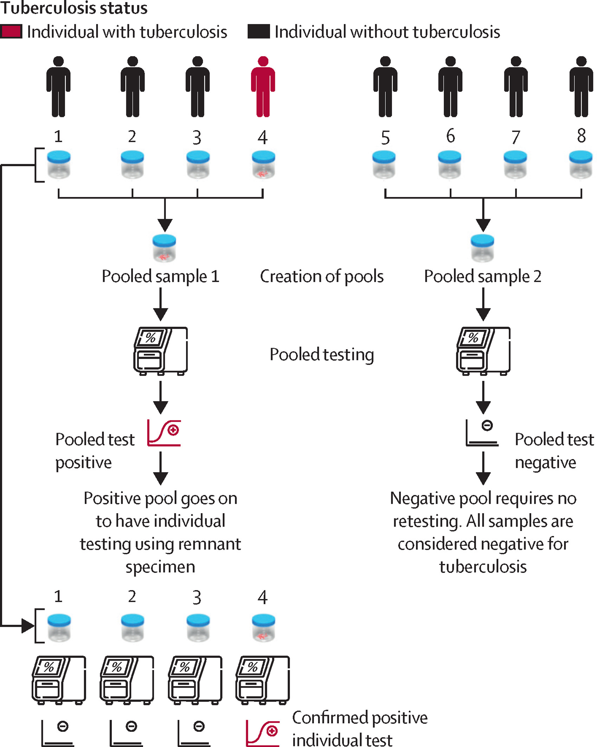
What is Pooled Testing
Interpretation of Results
If pooled result = MTB not detected → all specimens are interpreted as negative → no further testing is required
If pooled result = MTB detected or trace → perform individual testing for all specimens in the pool → use remaining processed specimen If pooled result = Error, invalid, or no result (non-valid) Follow the Laboratory procedure for non-valid results. → Repeat pooled test if volume remains, OR → Perform individual testing of all specimens in the pool. Clinical decisions are based on the individual test results.

Slide 5
When to Use
Pooled Testing
Key conditions:
Low to moderate positivity (<30%)
Adequate sputum volume
Ability to perform reflex testing
Typical settings:
Community screening
High throughput laboratories
Outreach campaigns

Slide 6
When NOT to
Use Pooled Testing
❌ High TB positivity settings
❌ Insufficient sputum volume
❌ Invalid samples such as extrapulmonary samples
❌ Need for immediate individual result (e.g. risk of drug-resistant TB)
❌ Risk of paucibacillary TB including children, people living with HIV, and those with prior TB treatment

Slide 7

Sputum (≥2 mL)
Optional: Take a swab for smear microscopy
INDIVIDUAL TESTING
Add 2 parts of SR to 1 part of sputum
POOLED TESTING
Total volume sputum /
SR mixture: ≥6 mL
2 mL of mixture
4 consecutive samples available
< 4 samples available
Individual Xpert Ultra assay
Repeat
Fridge available
Fridge unavailable
Store samples overnight
MTB Detected OR Not Detected
Invalid/Error/No results
Additional samples available to complete pools of 4 on following day
Report result to clinical team
Yes
No
Create pools of 4 samples
(1 mL from each sample in pool)
Pool remaining samples
(1.5 mL from each sample in pool)
Standard of Care
Shake 10 to 20 times or vortex for at least 10 seconds for full homogenisation
Sputum Sample Flow for Pooled Testing
2 mL of pooled mixture
Pooled Xpert Ultra assay
Repeat
Record result
MTB Detected OR Not Detected
Invalid/Error/No results

Slide 8
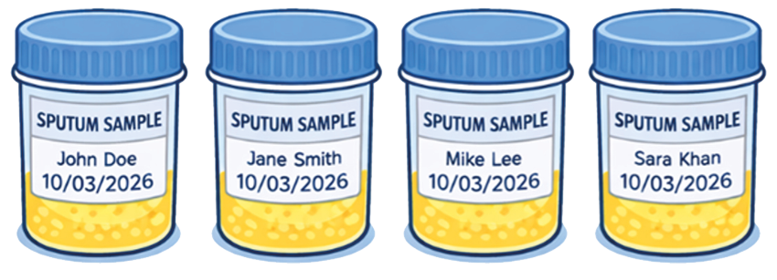
Specimen Eligibility
Receive specimen
2. Check specimen eligibility
Sputum (not saliva)
Adequate quality
Minimum volume (> 1 mL)
Correctly labelled

Slide 9
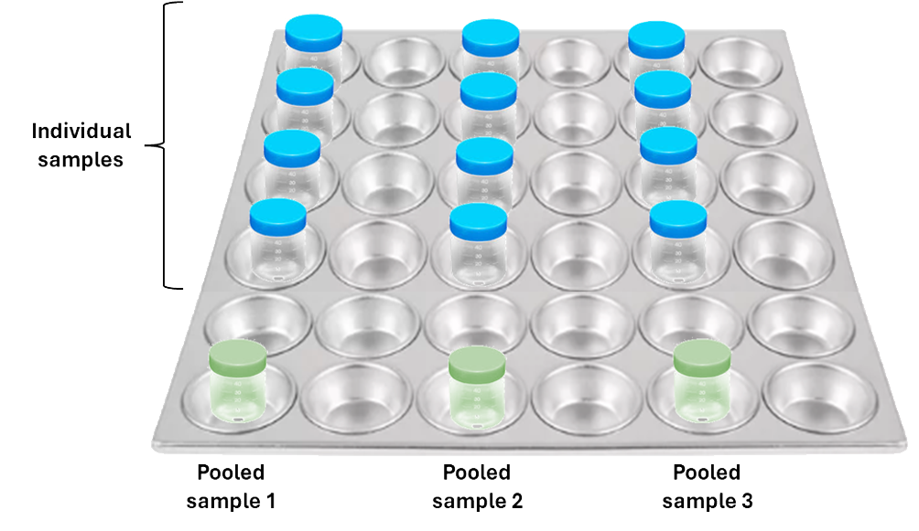
Preparing Samples
Arrange specimens in a muffin tray so samples for one pool are in the same row.
Add an empty container in line to serve as the pooled sample container.
For pools of four, place four containers in adjacent wells.
This helps organise specimens and prevents mixing errors.

Slide 10
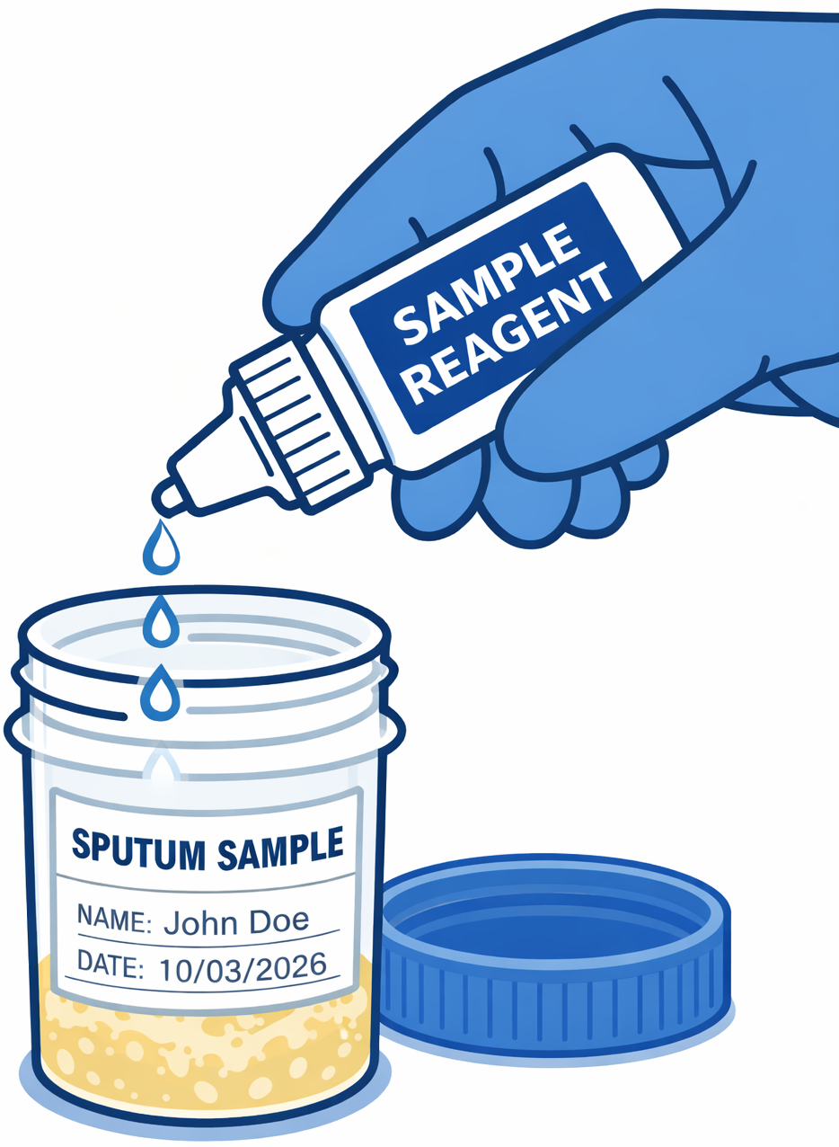
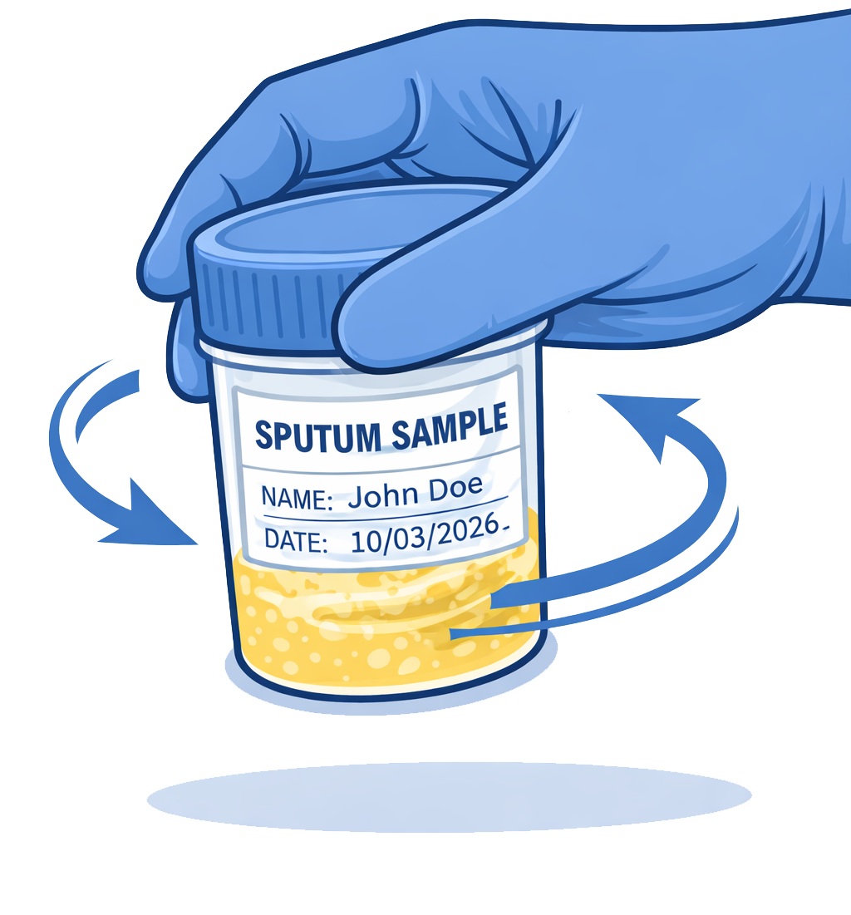


Preparing Samples
Process specimen with sample reagent according to manufacturer’s instructions:
A.
B.
C.
D.
E.
10-20 times
10-20 times

Slide 11
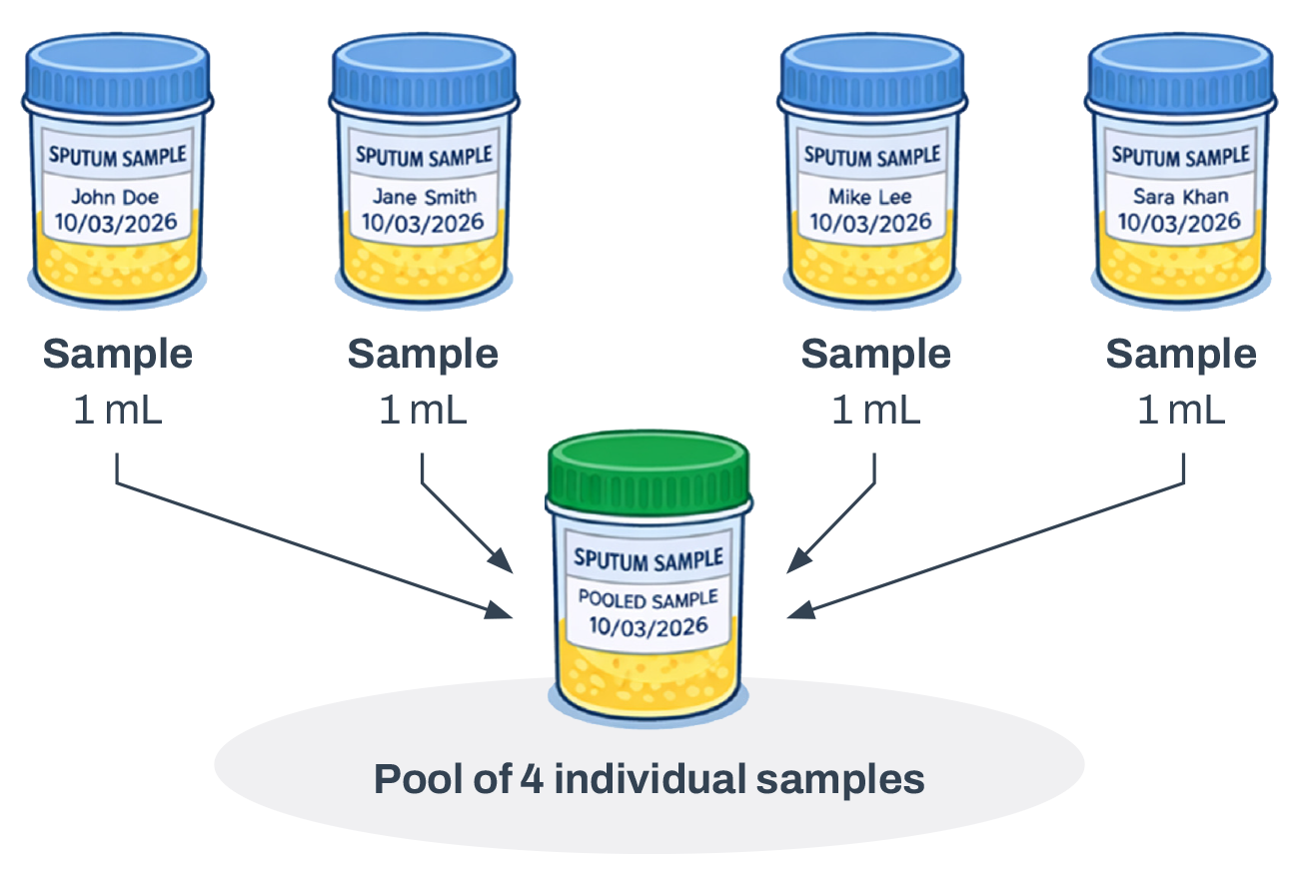
Forming the Pool
Label pool container
Mix the specimen-reagent mixture briefly to re-homogenise
Transfer an equal aliquot using a new sterile pipette or pipette tip
Combine aliquots into the pool container
Mix pooled sample
Example of preparing a ~4 mL pool of four samples

Slide 12
Running the Pooled Test
After aliquoting all specimens, gently mix the pooled sample to ensure uniformity.
Using a sterile pipette, transfer the required volume of the pooled sample into the cartridge or reaction tube and run the test on the LC-aNAAT platform following standard procedures.
Where possible, prepare pools and load cartridges in separate areas to reduce the risk of cross contamination.

Slide 13
Interpretation
of Pooled Results
Pooled Result | Action Required | Final Interpretation
MTB not detected | No further testing required | All individuals considered negative according to the molecular test result
MTB detected | Perform individual testing of all specimens in the pool | Individual results determine final diagnosis
MTB detected (trace) | Perform individual testing of all specimens in the pool | Individual results determine final diagnosis
Error / invalid / no result | Repeat pooled test or proceed to individual testing according to laboratory procedures | Based on repeat or individual results

Slide 14
Reflex Individual Testing
If the pooled test result is MTB detected (including trace), each individual specimen included in the pool must undergo deconvolution individual testing:
Retrieve all processed individual specimens that contributed to the pool.
Mix each specimen again briefly to re-homogenise.
Perform individual LC-aNAAT testing following the standard testing procedure.

Slide 15
Preventing Errors
and Contamination
Key points:
New pipette for each sample
Equal volumes
Keep containers closed
Clean workspace
Separate samples (individual and pooled) and cartridge loading areas

Slide 16
Traceability and
Sample Tracking
Each specimen must have a unique individual identifier.
Each pool must be assigned a unique Pool ID.
Pool IDs must be linked to all specimens included in that pool to allow traceability and individual retesting if needed.
Example:
Pool ID | Specimen ID 1 | Specimen ID 2 | Specimen ID 3 | Specimen ID 4
LIV-20260309-P01 | TB-001245 | TB-001246 | TB-001247 | TB-001248

Slide 17
Recording of
Pooled Test Results
Minimum information to record in the laboratory register or electronic laboratory information system (LIS) used for routine LC-aNAAT testing:
Pool ID
Date of testing
Pool size
Individual specimen IDs included in the pool
Individual test result when applicable
Pooled test result (MTB trace detected, MTB not detected, error, invalid, or no result), initial test result and repeated, if any
Linking pooled and individual samples:
Where possible, add a Pool ID column in the laboratory register.
If registers cannot be modified, use a separate pooled testing log sheet to track pools

Slide 18
Reporting of Results
Final results must always be reported at the individual specimen level for clinical management as in routine individual testing:
If the pooled test is MTB not detected, report each specimen as MTB not detected
If the pooled test is MTB detected (including trace), report individual results after reflex testing
If the pooled test is Error / invalid / no result, report individual results after repeat or reflex testing

Slide 19
Quality Assurance
and Quality Control
Monitoring unexpected results:
- Positive pool but all individual tests negative
- Unexpected increase in positive pools
- Increase in non-valid results (Error / invalid / no result)
- Failure to perform deconvolution testing of all specimens in positive pools
Monitor discordant pooled testing results:
- Expected rate ~3 to 10% (positive pool, all individual MTB not detected), mainly with very low or trace results
Rates outside this range or high / medium / low pooled results with all individual MTB not detected should trigger review and repeat testing
Check: Specimen identification, pipetting, workspace organisation, and SOP adherence.

Slide 20
Documentation
and Corrective Actions
Document all non-valid results (Error / invalid / no result), procedural errors, and corrective actions. Corrective actions may include:
Repeating tests (if specimen volume remains)
Reviewing pooled testing procedures
Retraining staff on aliquoting and specimen identification
Checking instrument maintenance and calibration
Report major deviations to laboratory supervisors.

Slide 21
External Quality
Assurance
Continue participation in LC-aNAAT EQA programmes.
Include pooled testing in:
Proficiency testing schemes
Supervisory visits and laboratory audits
NTP laboratory quality monitoring systems
Ensures pooled testing maintains diagnostic performance comparable to individual testing

Slide 22










The Start4All Partnership

Slide 23
Acknowledgements
The Start4All consortium expresses its thanks to all stakeholders, collaborators, and participants who supported our research efforts.
For more information, see our online Acknowledgements page: www.lstmed.ac.uk/start4all/acknowledgements
Start4All is funded by Unitaid

Slide 24
lstmed.ac.uk/start4all

